Slide 1

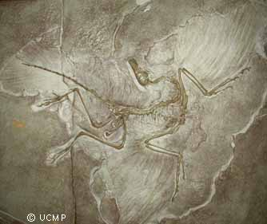
Archaeopteryx
(photo from UMCP Berkeley collection: Archaeopteryx)
Cecilia Leumas

Slide 2
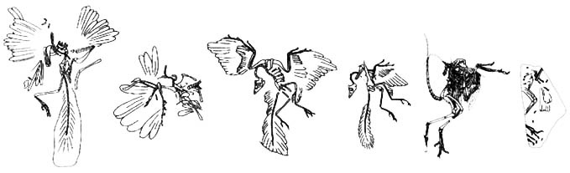
Archaeopteryx Fossil Record
Eight Archaeopteryx fossils, dating to the late Jurassic, have been discovered in and around Solnhofen, Germany. The Solnhofen formation consists of a fine grain limestone which preserves very well, so that intricate feather detail is visible in each specimen. If only bones had been preserved, Archaeopteryx would probably have been classified as just another small, flightless theropod.
(Liem et al; All About Archaeopteryx)
(The London, Maxburg, Berlin, Eichstatt, Solnhofen, and Teyler/Haarlem specimens, courtesy of All About Archaeopteryx)

Slide 3
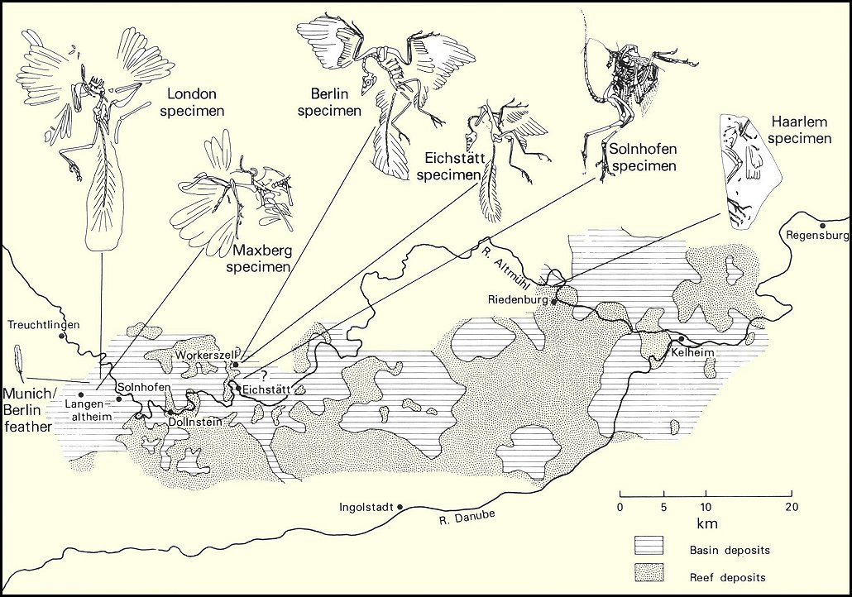
Sites of discovery for the seven Archaeopteryx lithographica specimens
(from the Morrison, CO Natural History Museum--MNHM - Archaeopteryx Exhibit)

Slide 4

1858: Maxburg Specimen
  Found by Eduard Opitsch near Langenaltheim, Germany, this specimen is still privately owned and not readily available for study.
1860: The Feather
  Discovered by Hermann Von Meyer near Solnhofen, Germany, this Archaeopteryx fossil has been identified as a secondary flight feather.
1861: London Specimen
  This specimen, also discovered by von Meyer, was found near Langenaltheim, Germany, and now resides in the British Museum of Natural History.
  Discovered only a few years after the publication of Darwin’s On the Origin of Species, this intermediate form provided support for the controversial theory of evolution.

Slide 5
1877: Berlin Specimen
  Discovered near Blumberg, Germany and now on display at the Berlin Museum, this fossil was even more useful than the London specimen in that it has a complete (but badly crushed) head.
1970: Teyler/Haarlem Specimen
  First discovered in 1855 near Reidenberg, Germany, this specimen was originally labeled by von Meyer as Pterodactylus crassipes.
  In 1970, Prof. John Ostrom identified it as Archaeopteryx.
1974: Eichstatt Specimen
  This fossil was also originally mislabeled, in this case as Compsognathus. It was first discovered near Workerszell, Germany, and later rediscovered and identified by Dr. Peter Wellnhofer.
  This is the smallest specimen and differs from the others in tooth structure and in having poorly ossified shoulder bones.
  Still classified in the same species as the above fossils (A. lithographica), it may represent a juvenile stage or an adaptation to a different ecological niche.
  This fossil is also unique in having the best preserved skull.

Slide 6
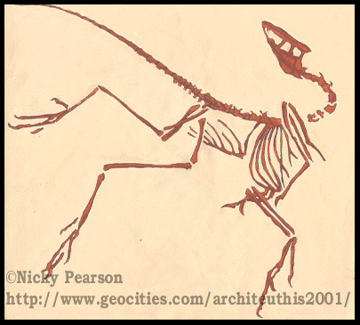
1988: Solnhofen Specimen
  This fossil was originally mis-identified as Compsognathus when it was discovered in the 1960s near Eichstatt, Germany.
  Described as Archaeopteryx by Wellnhofer after feather traces were revealed.
1992: Solnhofen-Aktien-Verein Specimen
  This most recently discovered specimen was been classified as a new species, A. bavarica, after being described by Wellnhofer.
  It is reported to show a small, ossified sternum.
ARCHAEOPTERYX by Nicky Pearson

Slide 7
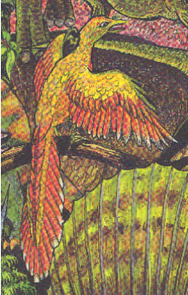
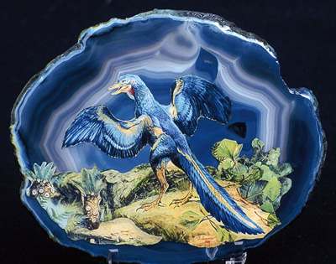
Many different speculative artistic representations have been made of Archaeopteryx; however, there are certain characteristics that are clear from the fossil record:
  About the size of a crow
    1.5 foot wingspan
    1 foot head to tail
  Probably capable of some flapping, powered flight
  Agile runner
  Carnivorous
Archaeopteryx by Brian Wigginton
Archaeopteryx shared various characters with modern birds as well as with dinosaurs.
Prehistoric Art of Archaeopteryx
Notes:
General physical description

Slide 8
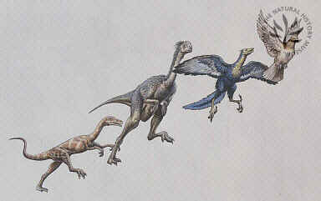
Avian Features of Archaeopteryx
London MNH Picture Library
Feathers
Capable of powered flight, though probably not strong or enduring.
Reduced fingers on pectoral appendages (wings)
Opposable hallux (big toe)
Pneumatic bones: contain air pockets for lightness
Furcula: 2 clavicles fused at the midline, a “wishbone”
Pubis elongate and posteriorly directed
The latter three features are also seen in some theropod dinosaurs.

Slide 9
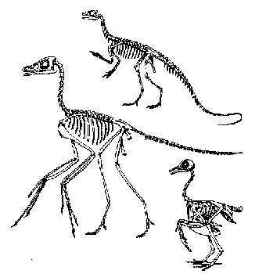
Reptilian Features
Toothed jaw, scaly head (no horny beak as in birds)
Keel on sternum flat relative to that of birds (but could support weak flight muscles)
Gastralia (ventral ribs) present
Unfused trunk vertebrae
Foramen magnum caudal, not ventral
Cervical vertebral centra amphicoelus (concave), not heterocoelus (saddle-shaped)
Sacrum occupies 6 vertebrae (11-23 in synsacrum of birds)
Skeletal comparisons between (clockwise from largest) Archaeopteryx, Compsognathus, and a pigeon. (Steven M. Carr)

Slide 10
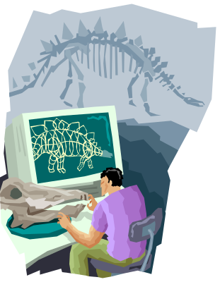
Evolutionary Importance
The Dino-Bird Link
  Archaeopteryx had more in common anatomically with dinosaurs than with birds, and is therefore useful to evolutionary theorists as a transitional form. (For a more in-depth discussion of its avian and reptilian features, see Chris Nedin’s All About Archaeopteryx website.)
  The fact that Archaeopteryx is a reptilomorph with distinctly avian features supports the idea of a link between dinosaurs and birds. However, Archaeopteryx is not generally considered to be that link, but rather an evolutionary “side branch” or “dead end.”
Endothermy
  The presence of feathers in Archaeopteryx fossils has sparked debate over the possibility that theropods and other dinosaurs may have been feathered and perhaps even endothermic.
  Evolution is thought to operate by altering the function of existing structures rather than by creating new ones. In concordance with this theory, many (e.g., Jeff Poling and Gregory Paul) believe that dinosaurs had insulating feathers on their integument for thermoregulation.
  Feathers became useful to Archaeopteryx as this animal developed a rudimentary form of avian flight.

Slide 11
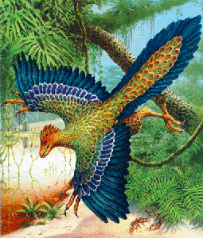
The Origin of Flight: Two Theories
Arboreal “Tree-Down” Theory:
  This theory argues that powered flight gradually evolved from gliding and jumping in trees. To move on to powered flight, the glider would at some point have begun flapping the stretched gliding surfaces of its pectoral appendages.
http://sparky.cs.nyu.edu:19234/arch1.gif

Slide 12
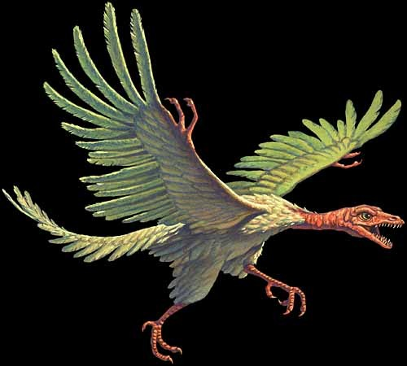
The Origin of Flight (continued)
Cursorial “Ground-up” Theory:
  Other theorists argue that flight began with running animals that would leap up into the air in pursuit of prey. Wings would have helped them to jump higher; a powered upstroke could have evolved form this action. Archaeopteryx likely used the three clawed fingers on its forelimbs to catch prey.
http://members.aol.com/Dinoplanet/arch.html

Slide 13
References
All About Archaeopteryx
daily-tangents.com: Archaeopteryx - A Prehistoric Bird from a Prehistoric World - Resource Summary - Sept. 1999
ARCHAEOPTERYX - Zoom Dinosaurs
Seven Skeletons and a Feather: The Mysteries of Archaeopteryx - Case Teaching Notes - Case Study Collection - National Center for Case Study Teaching in Science
Archaeopteryx classification
Journal of Dinosaur Paleontology
Liem, Bemis, Walker, Grande, Harcourt. Functional Anatomy of the Vertebrates: An Evolutionary Perspective. 3rd edition

